Slide 1
Statistical Arbitrage
Shan Ali, Tim Cheng, Pete Davis, Dylan Nikol, Matthew Streichler

Slide 2
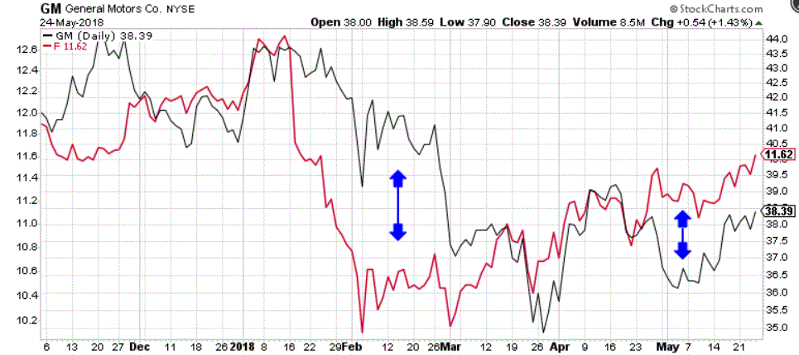
What is Statistical Arbitrage?
Opening both a long position and short position simultaneously to take advantage of inefficient pricing in correlated securities
Often referred to as “Pairs Trading”
Investors take advantage when highly correlated stocks get substantially out of sync with one another
Example of GM and Ford
2
Notes:
To our right, we have an example of GM and Ford
These stocks are known to be highly correlated to one another, and their prices will move together over time
In this time gap between February and March, we see that Ford dips well below GM, so this is where we would long Ford and short GM, expecting that their prices will once again converge

Slide 3
Risks of Statistical Arbitrage
It depends heavily on a stock’s ability to revert back to a historical normal (a.k.a. Mean Reversion)
Inefficiencies are often very miniscule, so large positions in both stocks are needed to generate sufficient returns
Need to exclude idiosyncratic risk for each stock
Don’t want stocks to diverge from each other
Specific to our analysis
We couldn’t get intraday data, so it will be difficult to optimize
3

Slide 4
Investment Thesis
We believe that we can take advantage of the market inefficiencies in the pricing of highly correlated stocks
We can find stocks that are highly correlated, and take advantage of periods when they are out of sync
To avoid data mining
We ensured that there was an intuitive reasoning behind the correlation
We implemented statistical tests to ensure academic reasoning behind the correlation
4

Slide 5
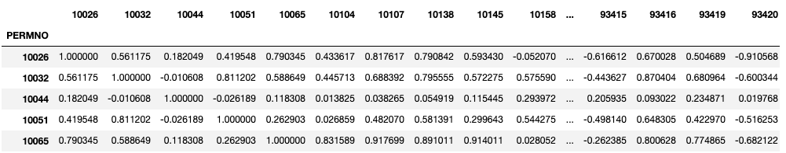
Finding Correlations
5

Slide 6
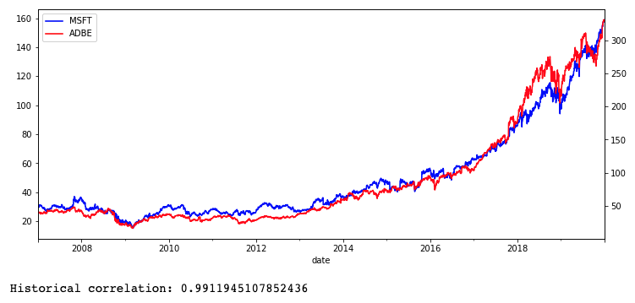
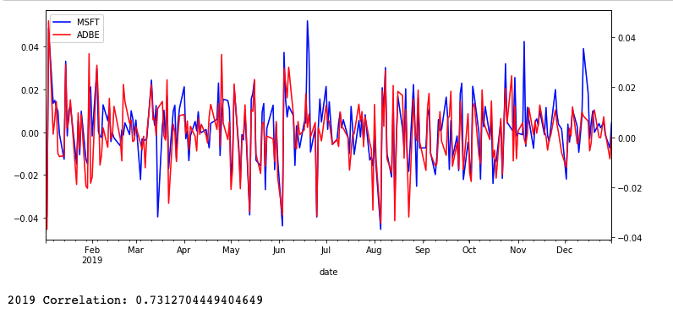
Correlations
6

Slide 7
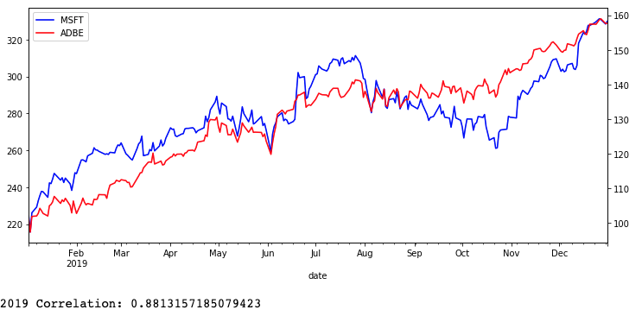
Correlations
7

Slide 8
Pairs chosen on correlation
(IDA, XEL) .9608 (SUI, ETR) .9786
(LMT, MANH) .9589 (GPN, SNPS) .9860
(SKY, LMT) .9630 (AWK, WEC) .9713
(NVDA, GOOGL) .9288 (ORA, Y) .9787
(PRFT, TPX) .9638 (MSFT, GIB) .9774
8

Slide 9
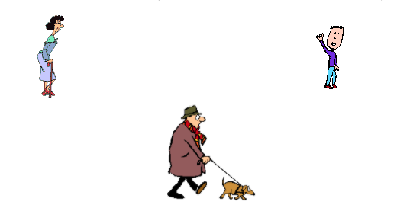
Cointegration (Engle Granger)
Hey, I’m on a random walk in the park
Us too!

Slide 10
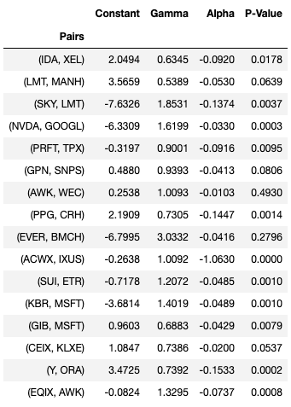
Dickey Fuller Test
(IDA, XEL) (GNFT, SHI)
(LMT, MANH) (GPN, SNPS)
(SKY, LMT) (AWK, WEC)
(NVDA, GOOGL) (ORA, Y)
(PRFT, TPX) (AWK, EQIX)
(GIB, MSFT) (KBR, MSFT)
(SUI, ETR)
9

Slide 11
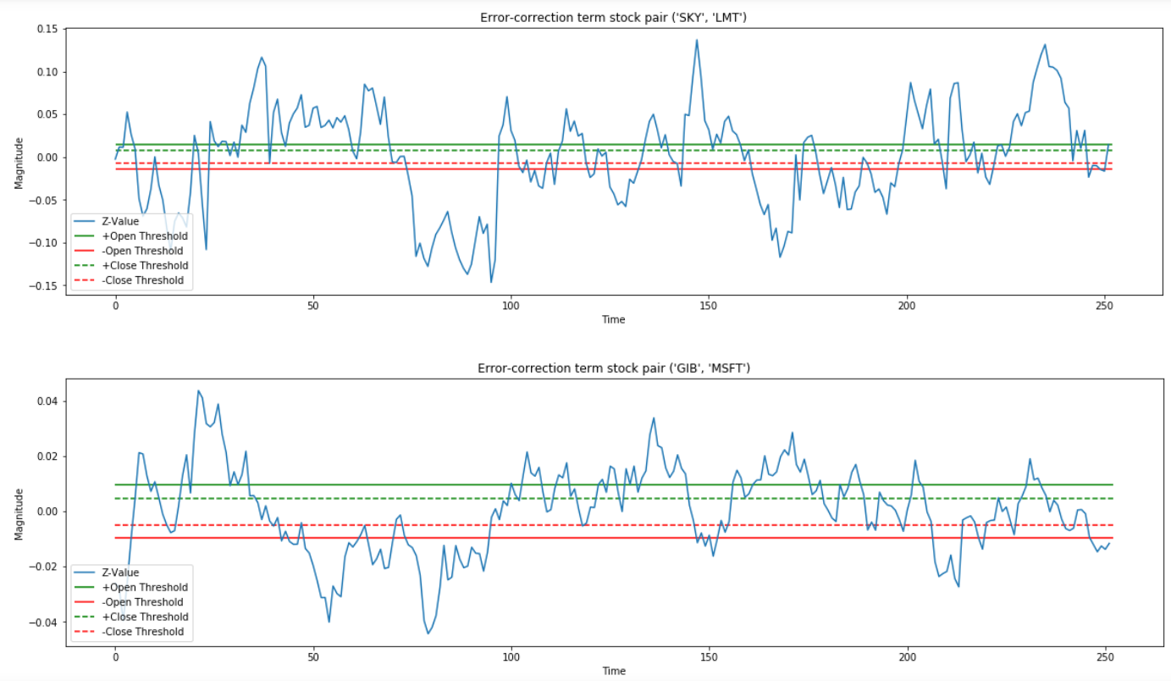
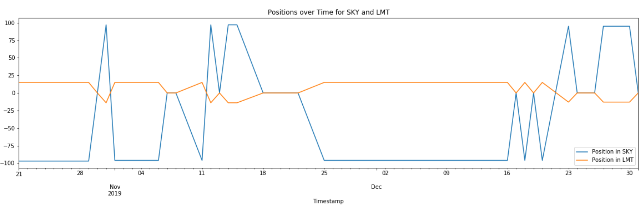
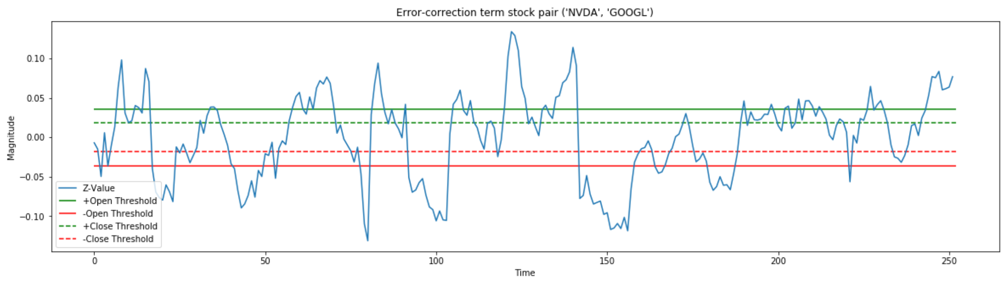
Algorithm
Single factor (price) model trained on data from 1-1-2018 to 10-20-19
Z-score:
Residuals / std
Enact long/short position when open threshold triggered
Close positions when reverted back to half threshold
Built positions on trading volume
Single position limit = 100 shares
Closes all positions on final trading day
10
Notes:
To implement our chosen pairs, we built an algorithm to simulate historical trading under our strategy. To use this model, we established trading thresholds on training data from Jan-2018 to Oct-2019. We use these thresholds to trigger trades when the z-score crosses its mark and closes the positions when we drop below the half the threshold. This minimizes the risk from holding our positions in a cases where mean reversion breaks. Positions are decided on available volume and hedging ratio with an artificial cap at 100 shares per opportunity. This is to reflect the realities of liquidity and minimize what would be the price impact. Additionally, aim to minimize idiosyncratic risk but excluding pairs on days when one is on the news. And lastly, we close all our positions on the final trading day.

Slide 12
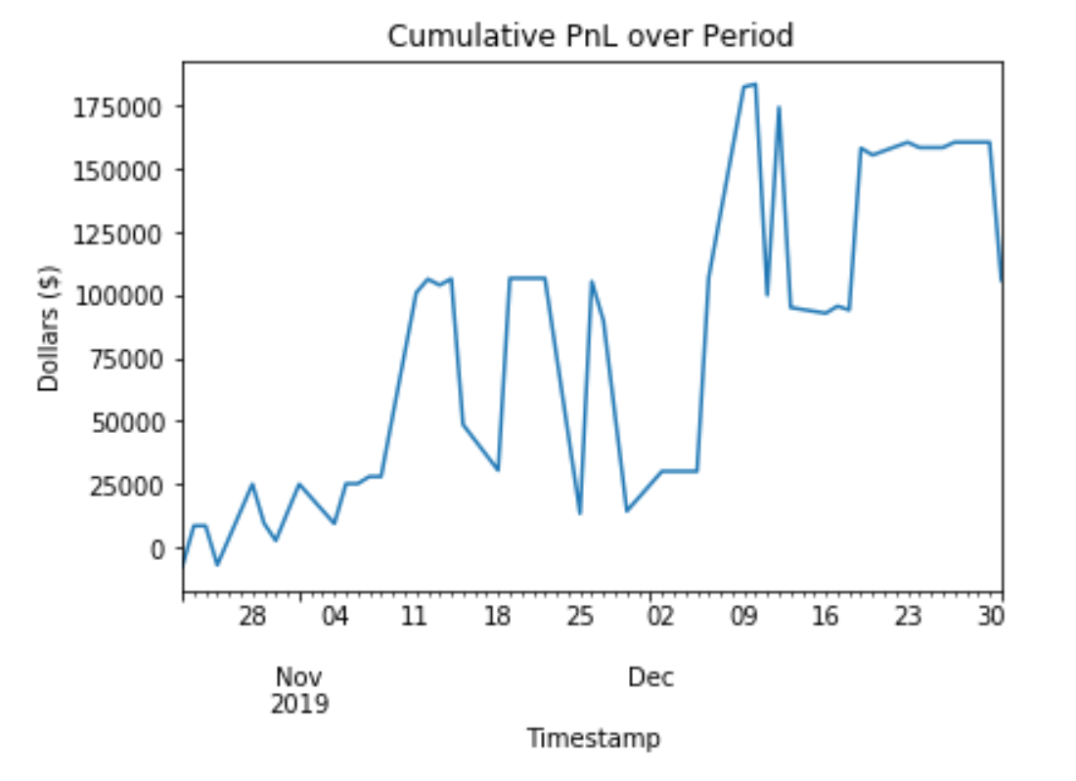

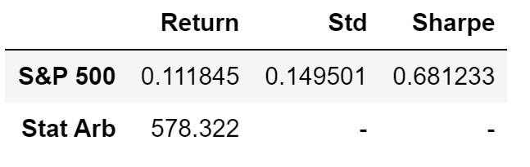
Results
Out-of-Sample Test on data from 10-21-2018 to 12-31-19
Made a profit of $105,808 USD
Portfolio size arbitrary
~$10k required to open initial positions
12
Notes:
To test the quality of our pairs and prove this wasn't just data mining, we tested our strategy on out-of-sample testing data from Oct-2019 through Dec-2019. This test resulted in a cumulative profit of about $105k. This is based on an arbitrary portfolio with size large enough to cover our positions, with ~10k required to open first and later profit should be sufficient to cover future positions. We struggled with quantifying our risk and return given the nature of dollar neutral positions and an unclear initial investment amount. We calculated a daily return on invested capital, we achieved roughly 19% per day on the $10,000 required to make the first trade.

Slide 13
Next Steps/Risks
Implement NLP sentiment analysis on news to detect when there is idiosyncratic risk associated with individual stocks
Pause trading on specific days or time periods of idiosyncratic risk exposure
Test our analysis on intraday data to see if returns, standard deviation, sharpe ratio outperform S&P 500 metrics
Risk: Price impact of trades

Slide 14
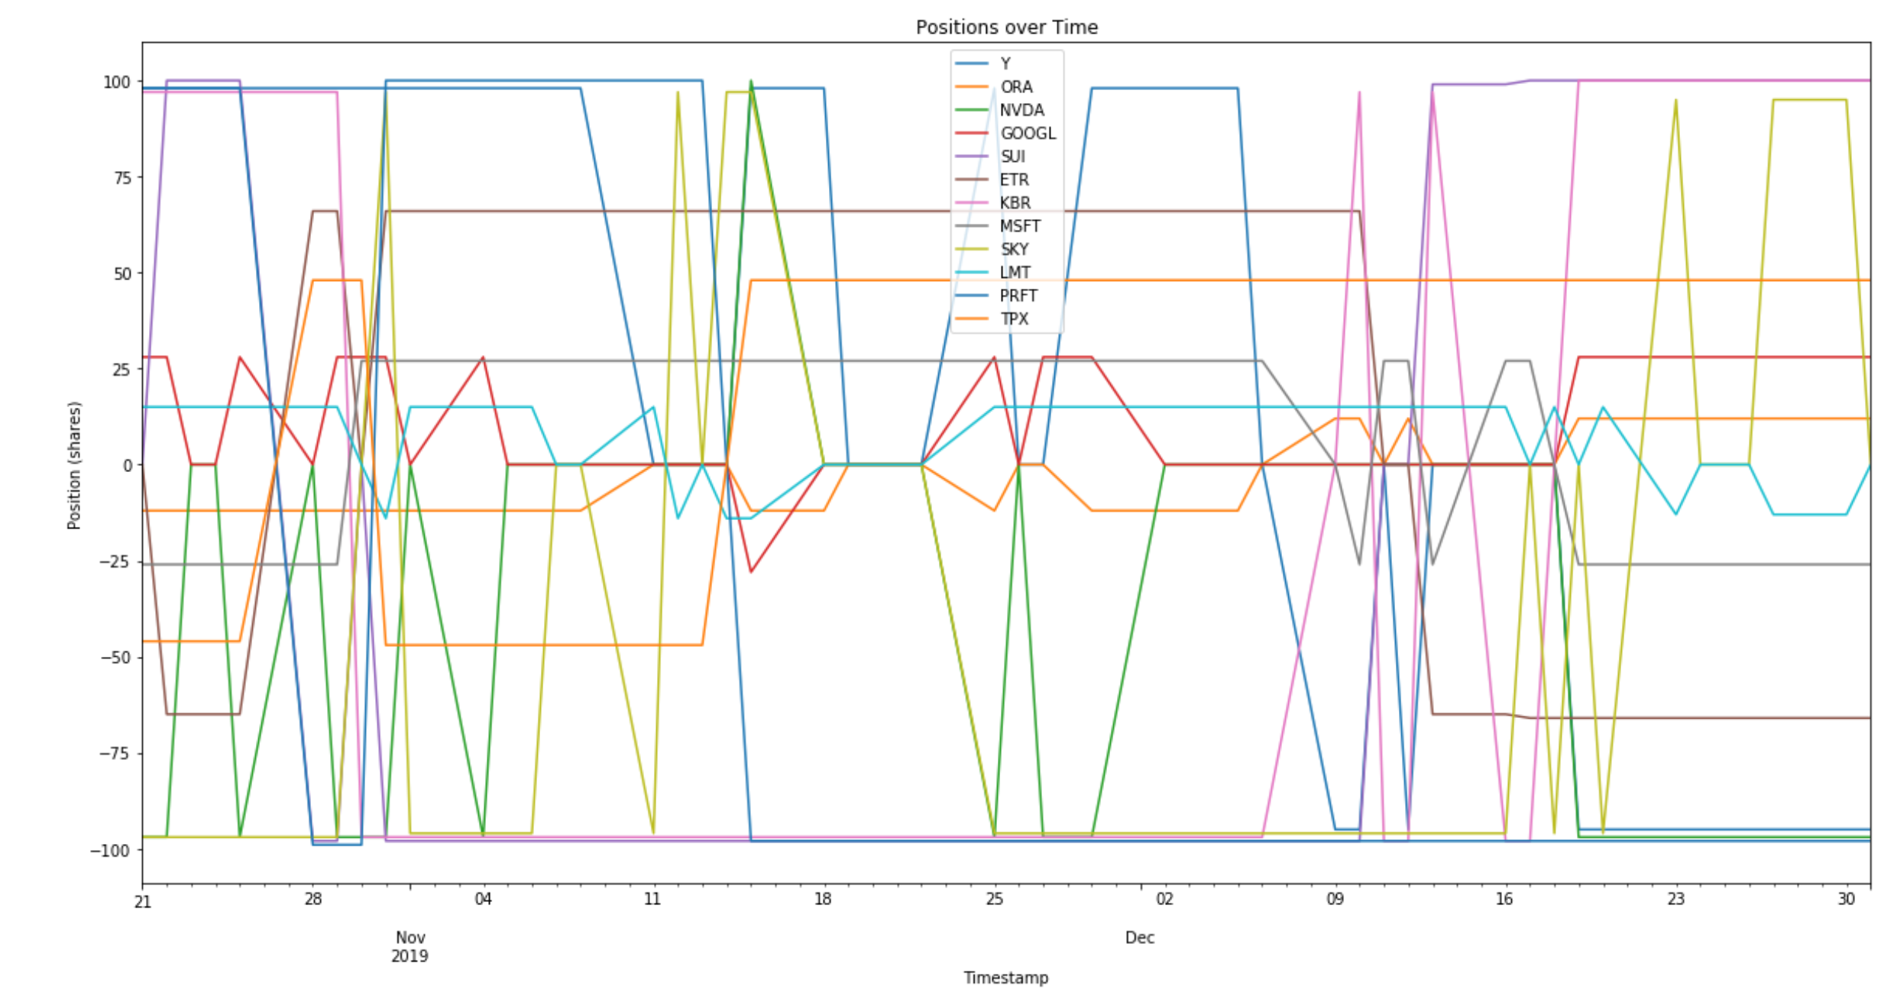
Thank you!

Slide 15
Sources
https://www.investopedia.com/terms/s/statisticalarbitrage.asp
https://wrds-www.wharton.upenn.edu/
13

